Slide 1
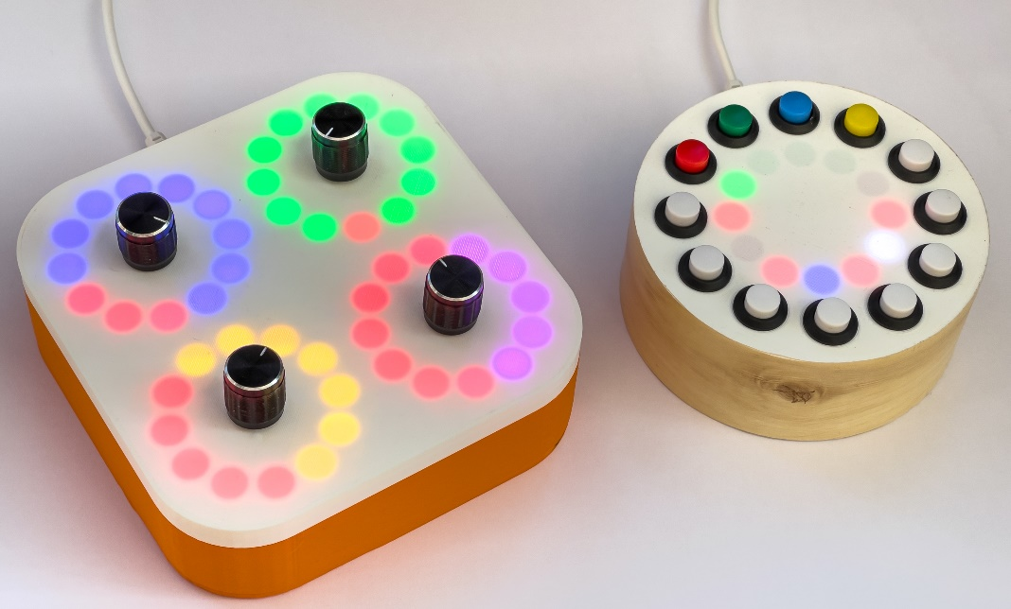
Make your own musical instruments with Python and Pure Data
Rob Miles
www.robmiles.com
@robmiles

Slide 2
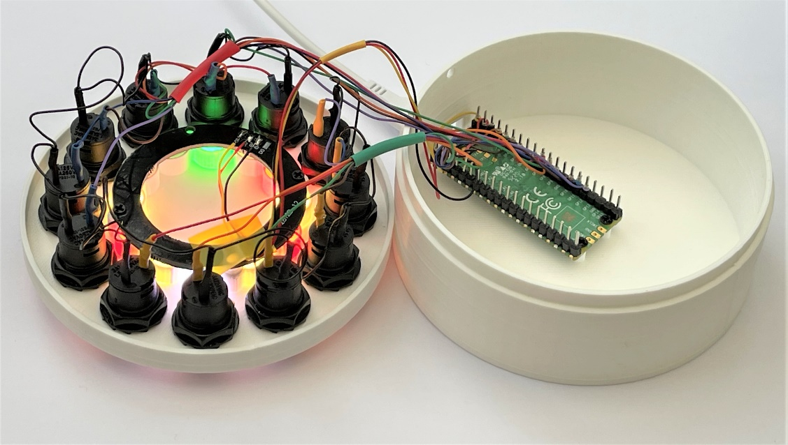
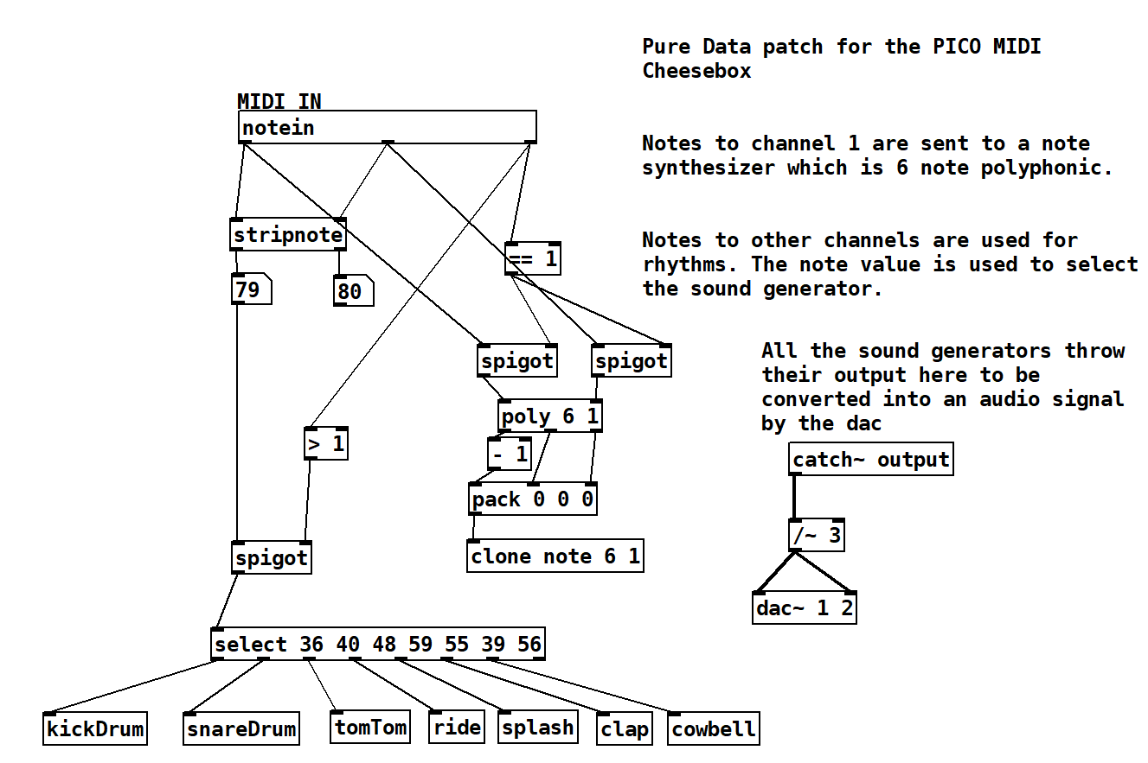
Overview
About Rob
Pure Data
Drums from Maths
Notes from MIDI
Making a Synth
Fun with hardware
Making music hardware
The Raspberry PI PICO
Circuit Python
Talking MIDI
The PICO MIDI CheeseBox
The PICO Crackers Controller
Summary

Slide 3

About Rob:
Taught Computer Science at Hull University
Spent many years twisting minds and crushing dreams
A Microsoft MVP
Blogs at: www.robmiles.com
Tweets at: @robmiles
Writes books….

Slide 4
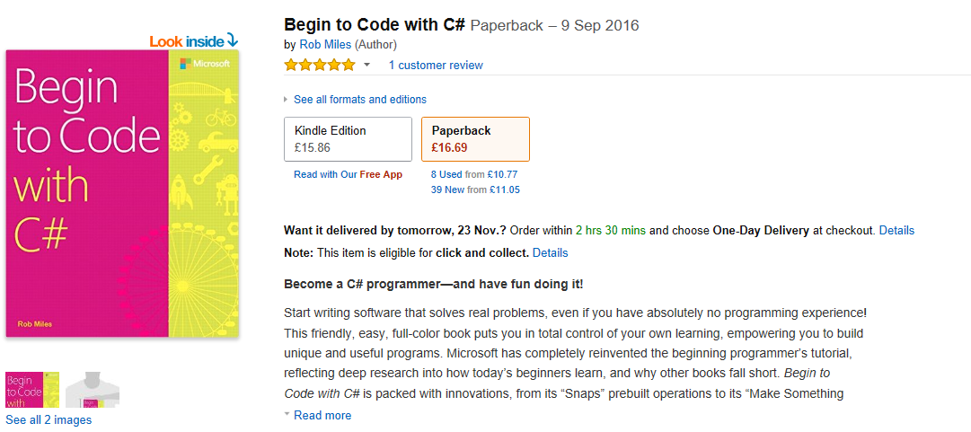
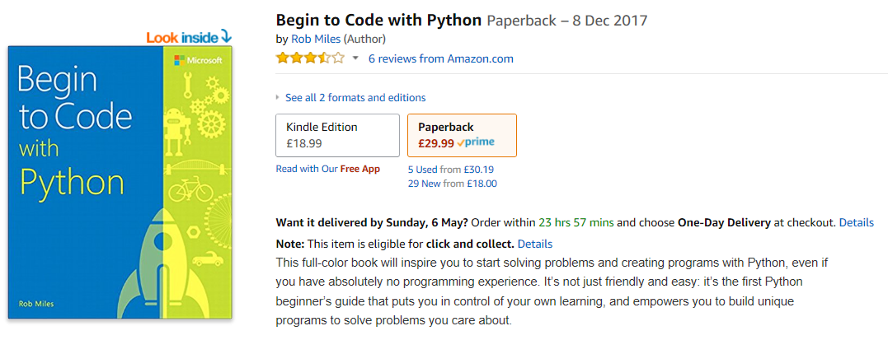
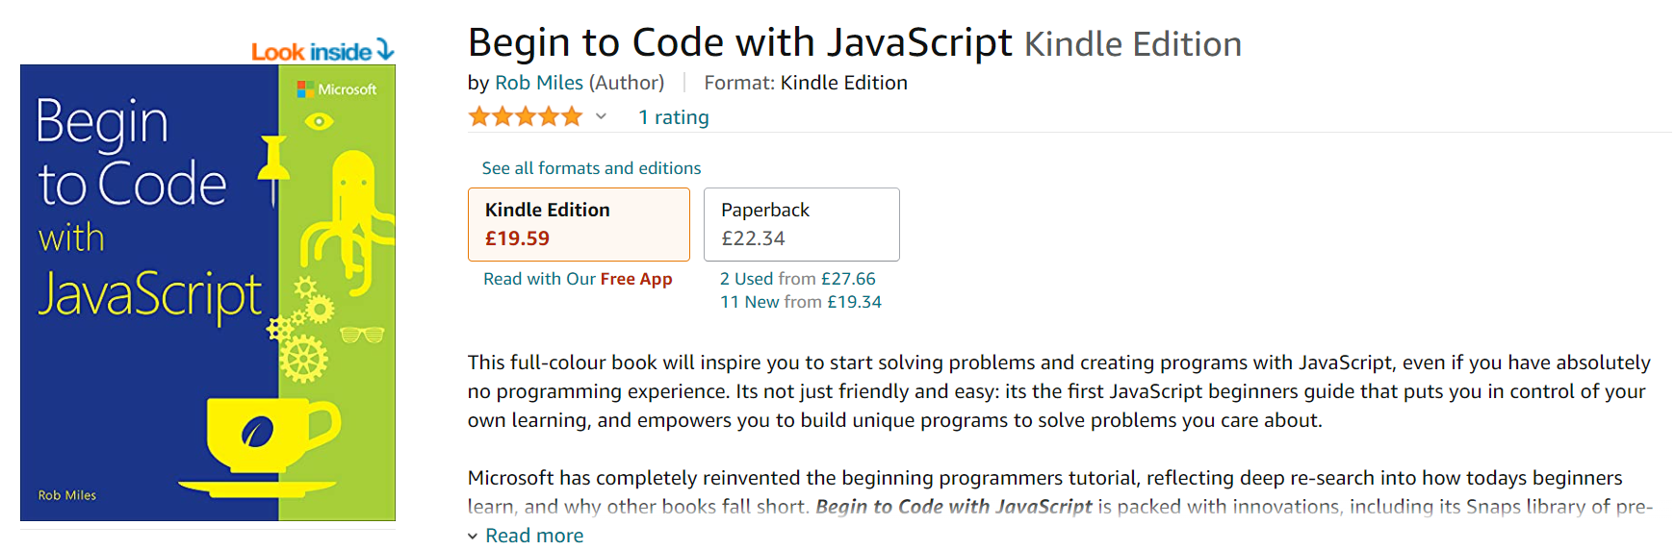
Begin to Code with C#

Slide 5
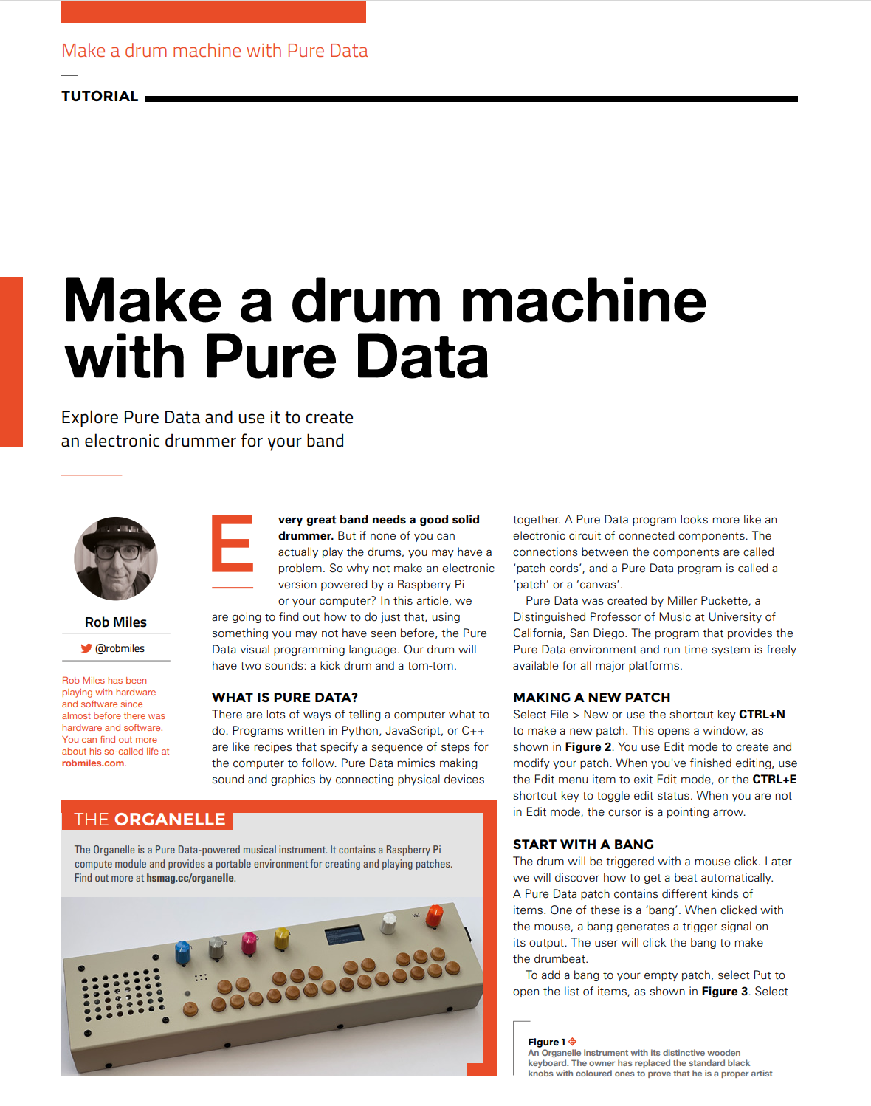
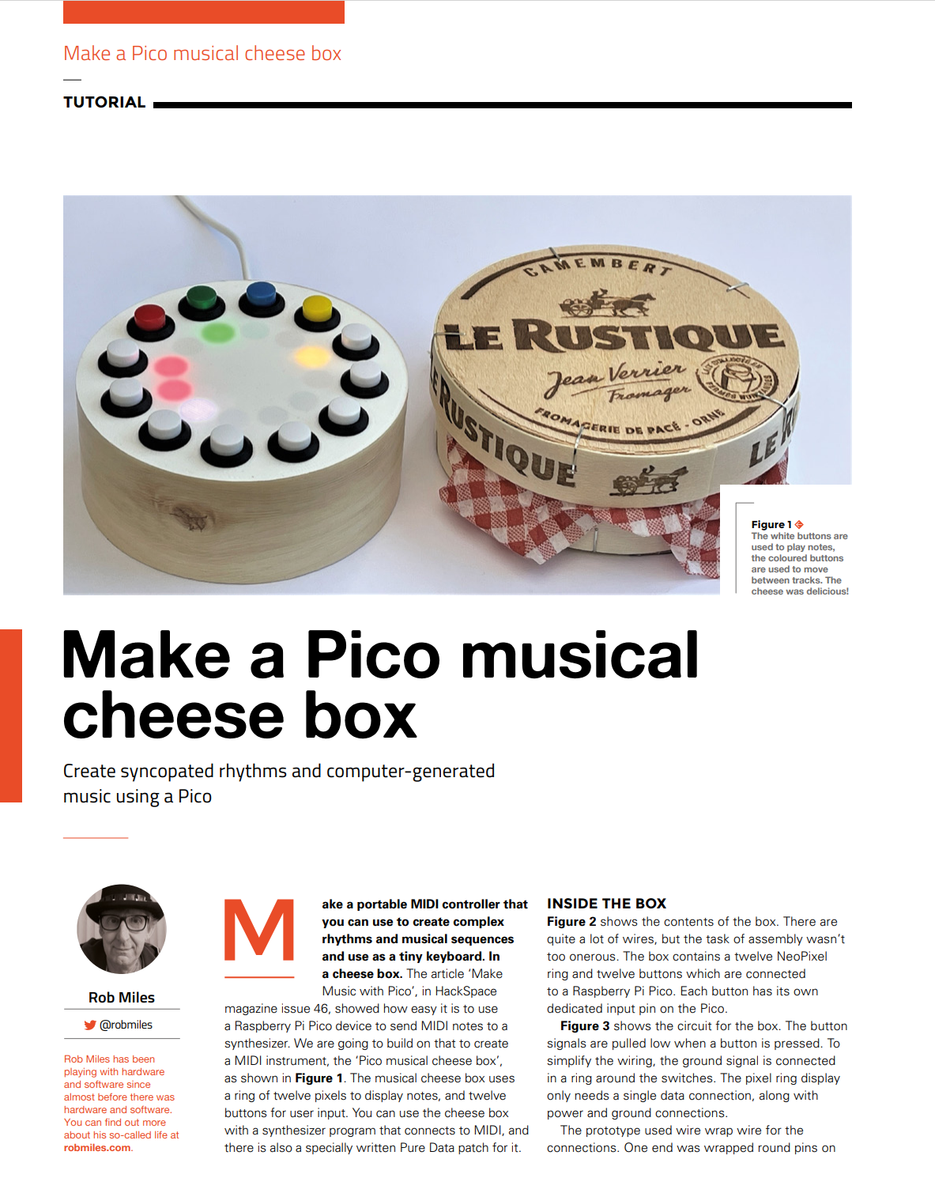
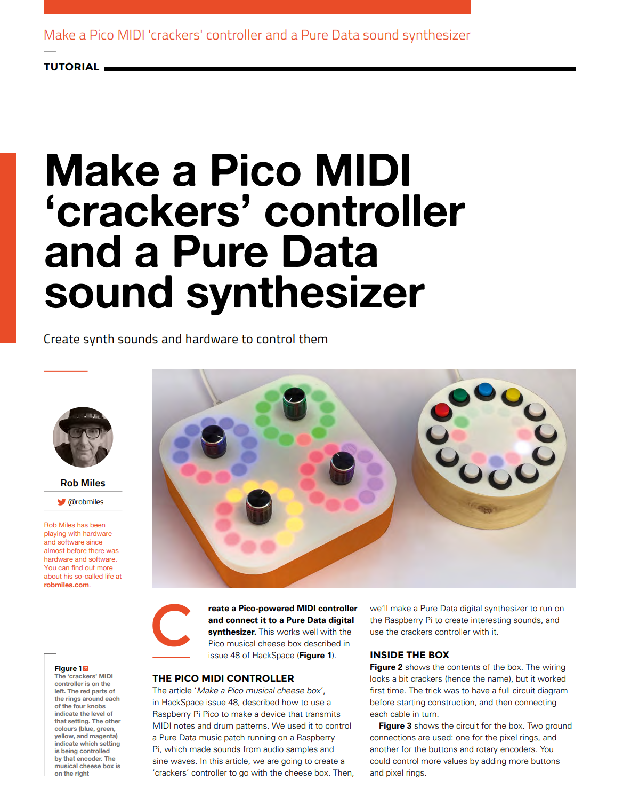
HackSpace
HackSpace magazine is a fantastic read
And you can read it for free ☺
You can find out more about this project in issues 47-49
hackspace.raspberrypi.com/issues

Slide 6
Pure Data

Slide 7
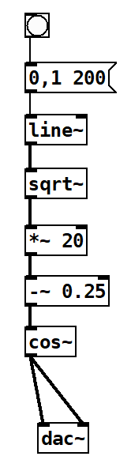
Making sounds with software
You can process sound signals using procedural code
If you want to try this, take a look at SuperCollider: https://supercollider.github.io/
However, this only works if you already know how to program
We are going to take a look at a platform called Pure Data
This provides a graphical sound processing environment in which you create signal processing behaviours by linking objects together

Slide 8
Pure Data
Pure Data has been around for many years
Pure Data programs are called “patches”
They are comprised of software objects linked by “patch cords”
The Pure Data program provides a graphical environment where you “wire up” the objects
There are objects that represent input and outputs
It is a great way to explore object oriented design
You can make your own objects and add them to a patch
There are also lots of community patches available

Slide 9

Getting Pure Data
You can download Pure Data from here for free:
puredata.info
There are versions for Windows, Mac, Linux and Raspberry Pi
They all run as a graphical application which you use to create the code

Slide 10
Let’s make a drum
We can start by making a digital kick drum using Pure Data

Slide 11

Making a kick drum
We are going to use Pure Data to create a kick drum sound
The kick drum is produced by a waveform that will be created by software
Kick drums start with a high pitched thump followed by a lower pitched sounds as the drum resonates

Slide 12
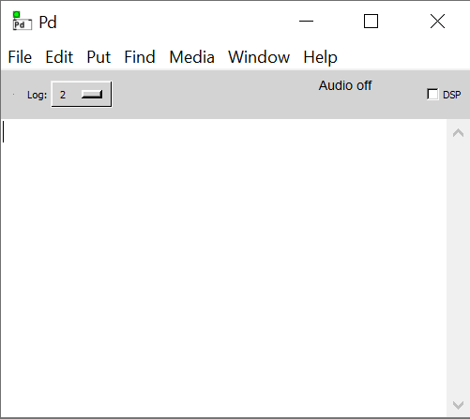
Starting
Pure Data runs as a graphical application which you use to create the code
When you start the program you get the console
You can’t use this for patches, you just use it to manage the application
Lets start with File->New to open an empty patch

Slide 13


Edit and Run Mode
When you’re working on a patch you can be in “edit” or “run” mode
In edit mode the cursor is a hand
In run mode the cursor is an arrow
You add objects and connections when in Edit mode
You interact with objects when in Run mode
But your patches are always running
You toggle between edit and run by pressing CTRL+E
You can also enter Run mode when editing by holding down the control key – very handy
Run
Edit

Slide 14
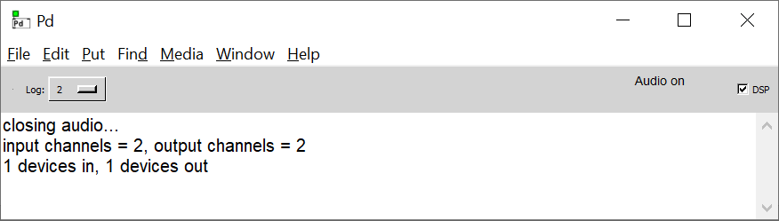
DSP means audio out
You can turn the audio on and off by using the DSP tickbox in the main window
DSP => Digital Signal Processing
If you have it on all the time you might get some loud sounds as you work on your patches

Slide 15
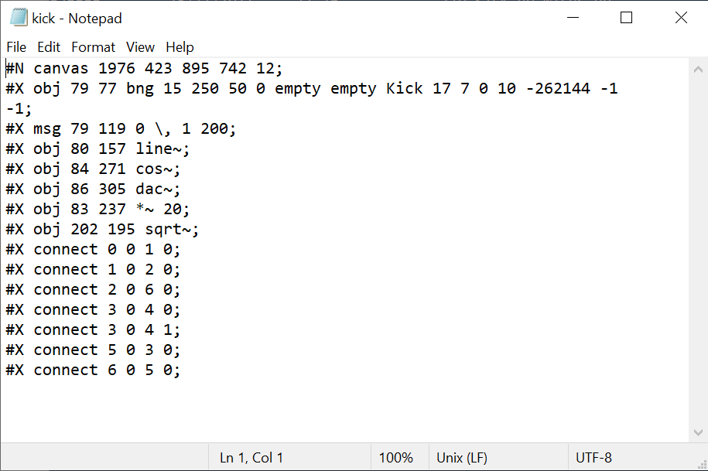
Writing patches
A patch is actually a file of text that specifies a bunch of Pure Data objects and how they are connected
You can edit this as a text file if you like
Please – don’t do this
Instead you use the Patch Editor built into the Pure Data environment

Slide 16
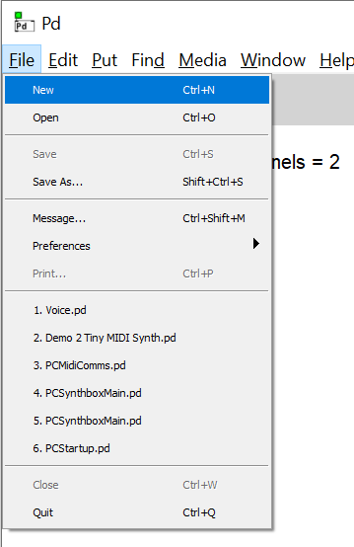
Make an empty patch
Create a new patch from the console using File->New
Don’t try putting Pure Data objects inside the console – you will only look silly
Patch files can refer to other patch files, so you can break a system down into components
Let’s make an empty patch and add some objects to it

Slide 17
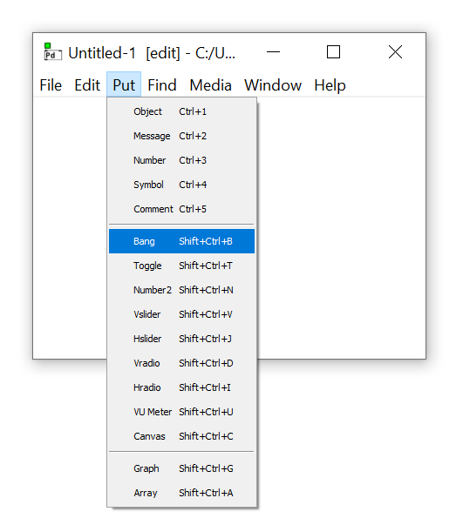
Bang object
We are going to start with a trigger object called a Bang
We select the Bang object from the Put menu
For more complicated objects we create an empty object and then type in the details of it

Slide 18
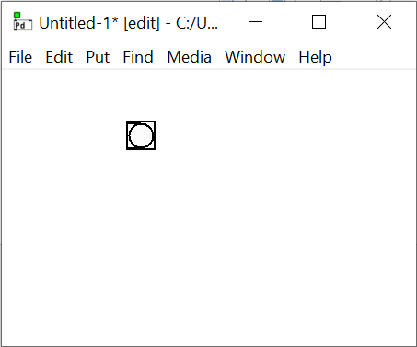
The Bang object
We can click on the Bang object to send a message out of the bottom of the object
We can only click on bangs when in run mode – otherwise we select them for editing
A bang message will trigger another object to do something
Our bang is going to trigger a kick drum

Slide 19
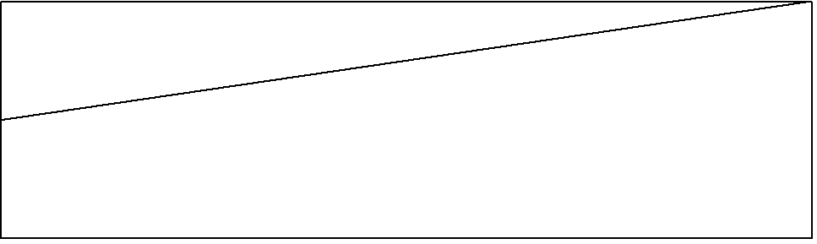
Start with a line
Our drum will be a waveform that sounds like a drum
Welcome to the world of electronic music ☺
We start with a waveform that is expressed as a line that goes from 0 to 1 over 200 milliseconds
200 milliseconds is the length of the sound that we want to make – that’s a fifth of a second
We will use the Pure Data line object to make this line
We need to create a message to tell line what waveform to make

Slide 20
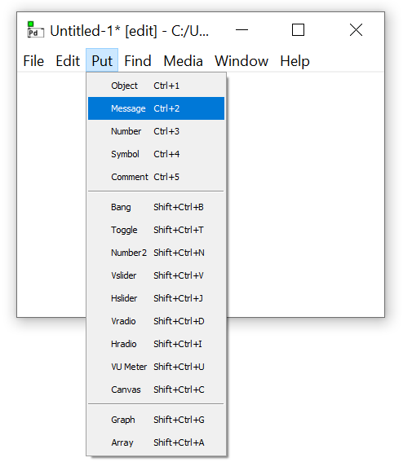
Make a message
The line object needs to be told what to do
We do this by sending a message to it
Let’s putting a message object into the patch
This is a special object type that we can find in the Put menu
When the message is triggered by the bang it sends the message out

Slide 21
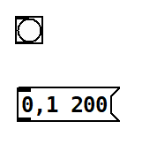
Message messages
The message object can contain multiple messages which are separated by a comma
We want to send two messages to the line
The first message is the value 0
This is the start level for the line
The second message is the value pair 1 200
This is the end level (1) and the duration in milliseconds of the line (200)

Slide 22
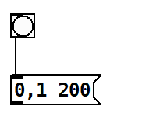
Linking objects
We now link the exit of the bang object to the input of the message
The inputs are on the top and the outputs are on the bottom
They are indicated by the black rectangles
Some objects have multiple inputs and outputs
We’ll see some of these later
Now we need to create a line object and connect the output of the message to it

Slide 23
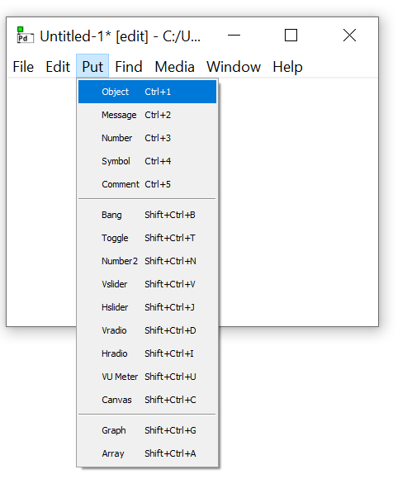
Add a line
There is no pre-set object for the line object
We make an empty object and then specify that it is a line

Slide 24
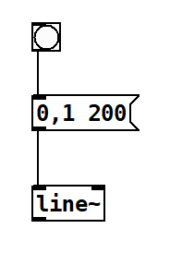
Lines make audio signals
The output of a line is an audio signal
This is signified by the addition of a ~ character on the end of the object name
We could send this signal to a speaker if we wanted
But it wouldn’t sound like much
The speaker cone would just move outwards over a fifth of a second

Slide 25
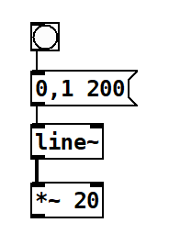
Make an interesting sound
I want the sound to contain 20 cycles
This will make the speaker go in and out 20 times
I can do this by multiplying the output of line by 20
This multiplies each value in the audio signal by the value as they pass through the object
Now they don’t go from 0 to 1, they go from 0 to 20
The output of the line is drawn as a thicker line – because it is audio
The multiplier operator has a ~ on the end to indicate that it is multiplying audio values

Slide 26
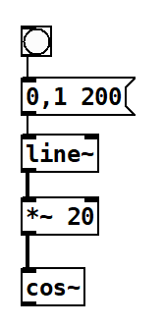
Create a sine cosine wave
At the moment we have a line that goes from 0 to 20 over 200 milliseconds
At regular intervals in the 200 milliseconds duration of the sound the line will make a new value
The next thing we do is take the “cosine” of the each value signal as it goes through
The cos object multiplies the incoming values by 360 degrees and then takes the cosine of that value
This means we get a cosine wave that goes between -1 and 1
We can use that to make a sound

Slide 27
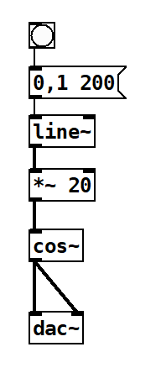
Digital to Analogue conversion
The dac object takes in a stream and sends the values to the sound output on the computer
It has two inputs, one for left and another for right
You can configure Pure Data to use different audio outputs
By default it uses the standard ones on your device
Remember to turn on the DSP first

Slide 28
Demo 1: A rubbish drum
Notes:
Setup: Connect the LaunchKey to the usb.
Start Pure Data
Select the MIDI input as Launchkey
Open up the Demo 01 Rubbish drum patch and show how it is appalling.

Slide 29
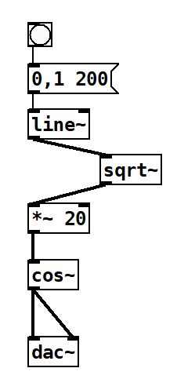
Better sound through mathematics
Our Drum sounds rubbish
This is because the frequency of the note is the same all the way through
We can make the sound more interesting by using some maths
If we take the square root of the values in the line we get a line that rises more quickly and then tails off
This will give us a much nicer drum sound

Slide 30
Demo 2: A kicking drum
Notes:
Open up the Demo 02 Kick drum patch and show how great it sounds.

Slide 31
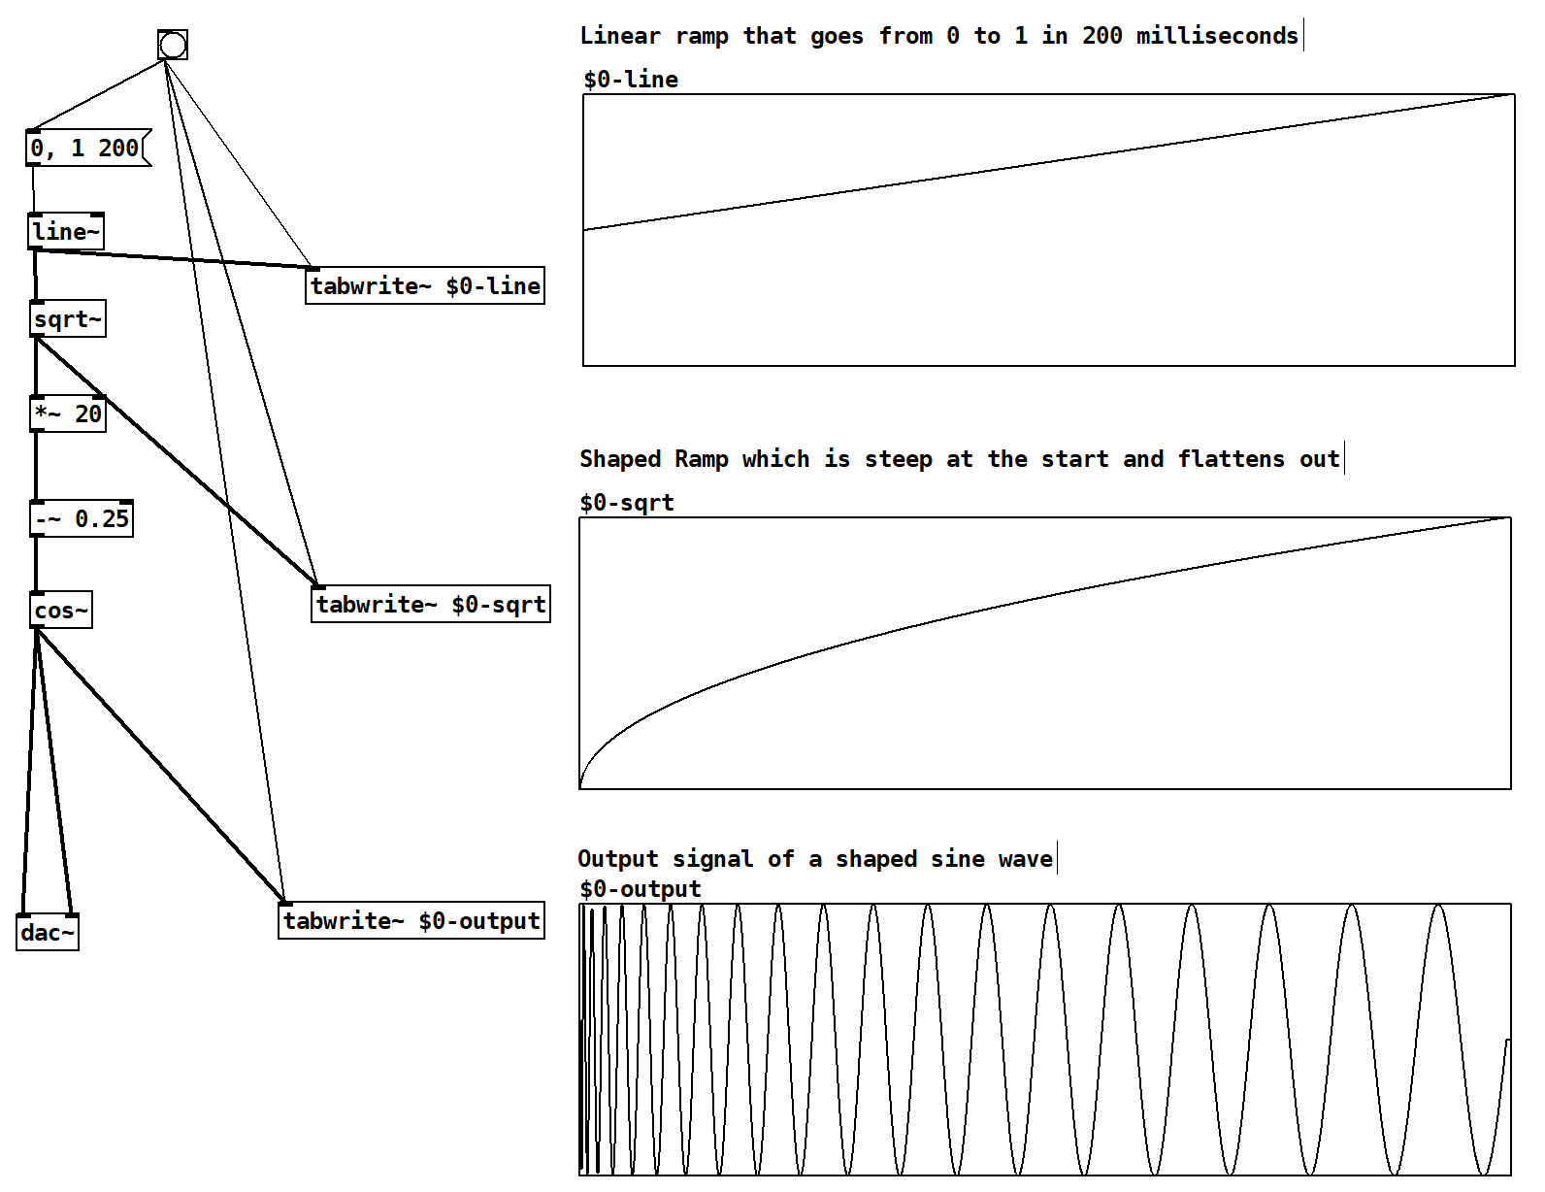
Signals
Pure Data can draw graphs of the audio signals
You can see that the line becomes a curve when we take the square root of the values
which makes a more interesting sound wave

Slide 32
Demo 3: Drum signals
Notes:
Open up the Demo 03 Drum signals patch and show how great it sounds.
Change the multipy by 40 to make more pulses and get a different sound.

Slide 33
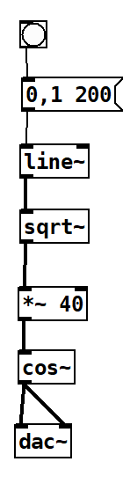
Change one number…
We can make a higher pitched “tom tom” sound just by changing the number of waveforms that are made
You can have a lot of fun just trying more numbers and doing more ramp shaping
You can also add noise and mix signals together

Slide 34
Playing notes

Slide 35
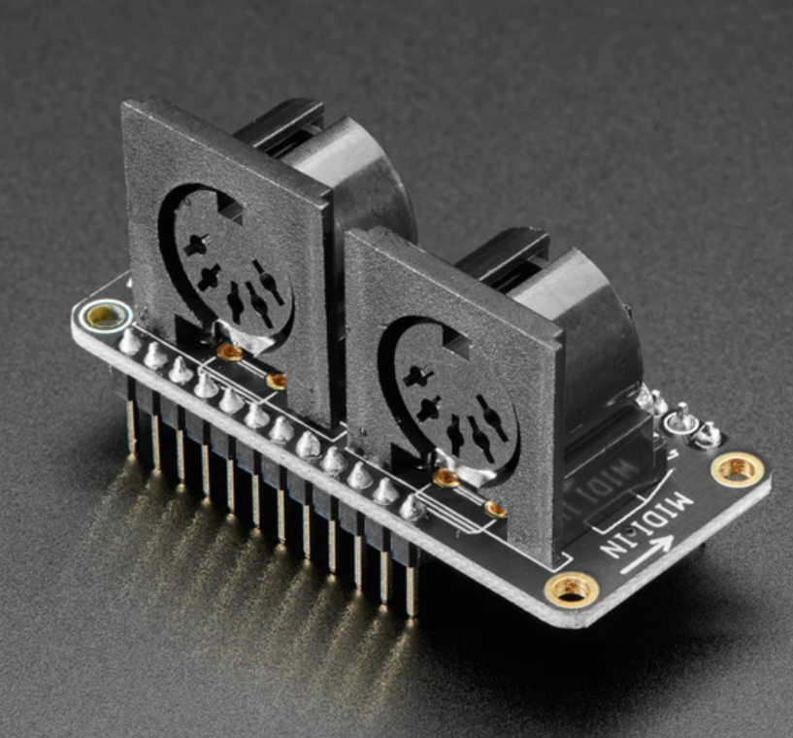
MIDI connections
The MIDI standard dates from the 1980s
It sends note on and note off messages along with control changes on 16 channels
It originally used funky DIN connectors and opto-isolators to connect devices
Nowadays we can use USB instead
Pure Data can receive note information from MIDI

Slide 36
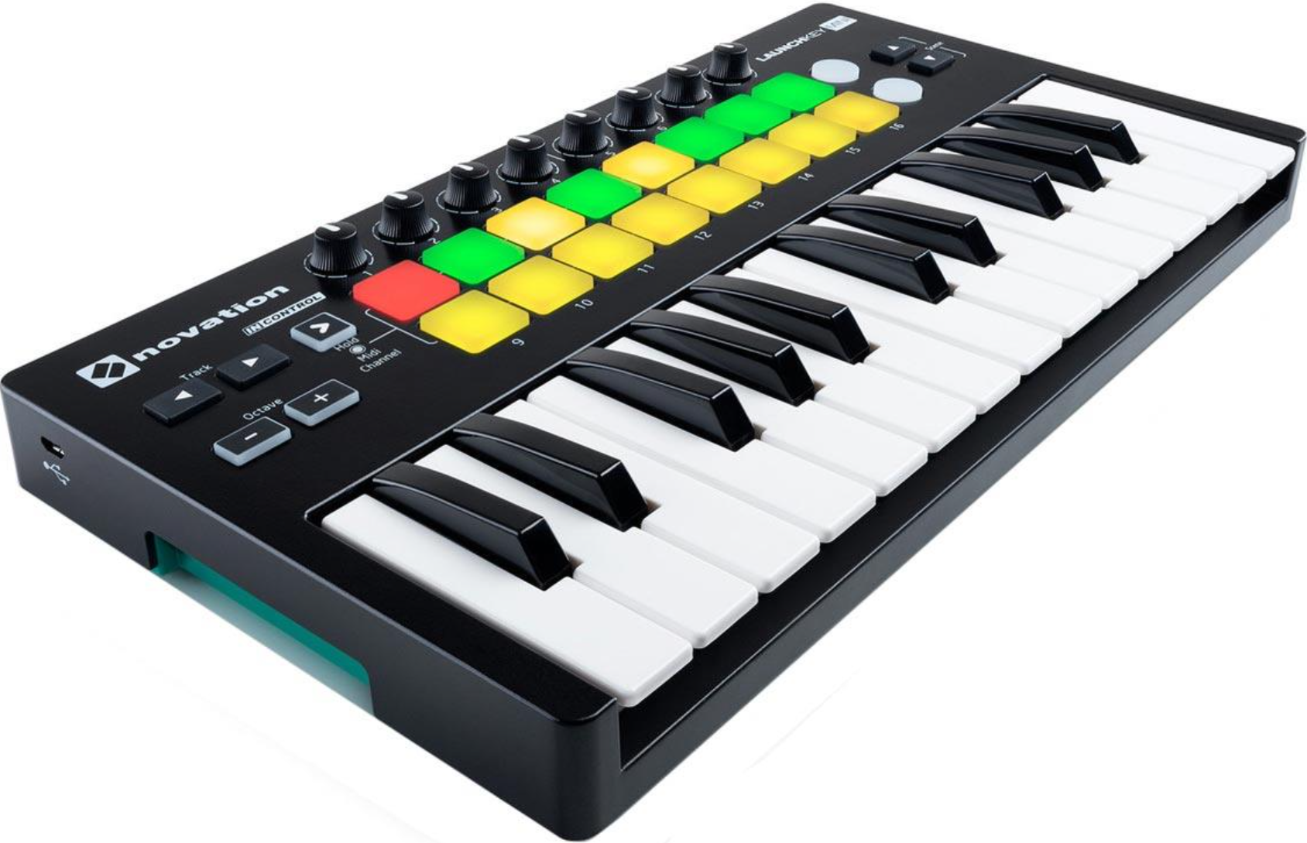
Midi Inputs
I’m using a LauchKey Mini to control the synthesizer
This has keys, pads and some rotary controls
You can pick these up quite cheaply on ebay
In the next session we will be making our own controllers using Raspberry Pi PICO devices

Slide 37
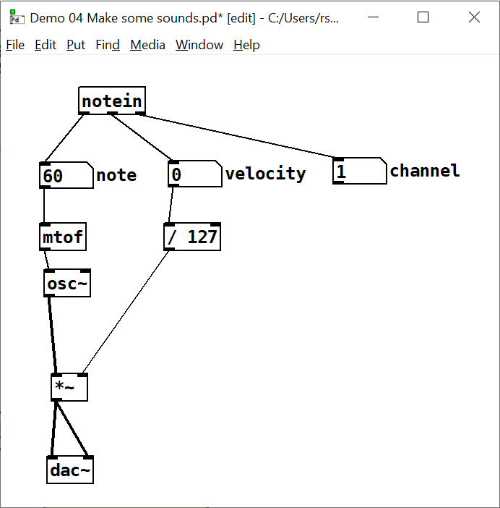
Synth patch
The patch on the right receives MIDI notes and then makes sounds
The keyboard sends a message when the note is pressed and another when the note is released
The note gives the note to play back
The velocity (0-127) sets the volume of the note
A note up message has a velocity of 0
The channel selects devices – there are 16

Slide 38
Note frequency path
This signal path plays the note
The mtof block takes a MIDI note and outputs its frequency
The osc block plays a note of that frequency
Note that the output is an audio signal
The *~ block is a multiplier
It acts as a volume control

Slide 39
Note amplitude path
This path controls the note level
The velocity is in the range 0 – 127
This is divided by 127 to get an amplitude value between 0 and 1
The *~ block is a multiplier
It acts as a volume control
When the amplitude is 0 none of the oscillator signal is sent through to the dac so the note stops

Slide 40
Demo 4: Simple keyboard
Notes:
Open up the Demo 04 Make some sounds patch and show how great it sounds.
Show how the velocity value affects the volume. Mention that the keyboard starts with a click (this is because the waveform is switched on rather than fading up). Also mention that you can’t play chords.

Slide 41
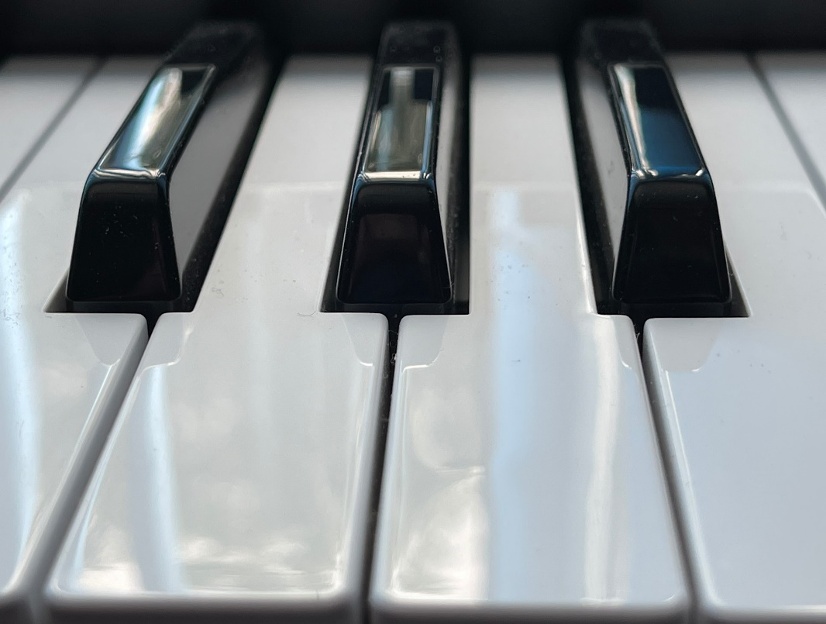
Keyboard developments
Good news
The keyboard works
The velocity of the keys affects how loud they sound when played
Bad news
You can’t play chords (more than one note at a time)
The keyboard sounds start with a click when the note is pressed
The sounds start when the key is pressed and end when it is released

Slide 42
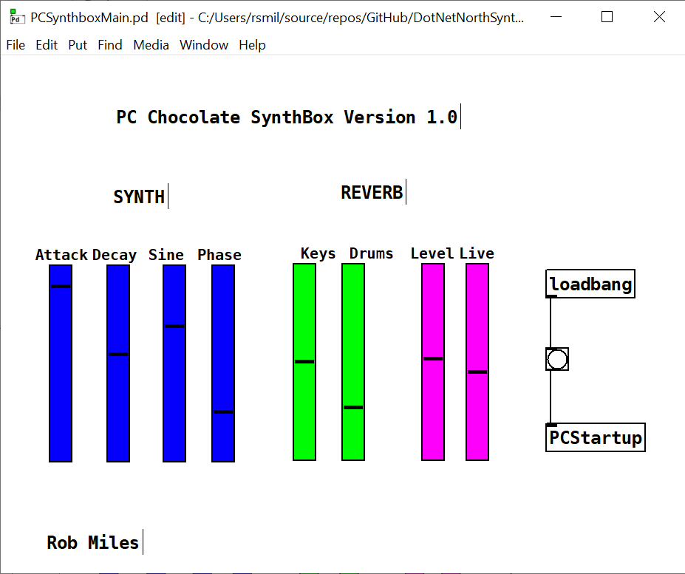
A proper synthesiser
The Chocolate Synthbox makes a more interesting synthesizer
Let’s take a look at how it works

Slide 43
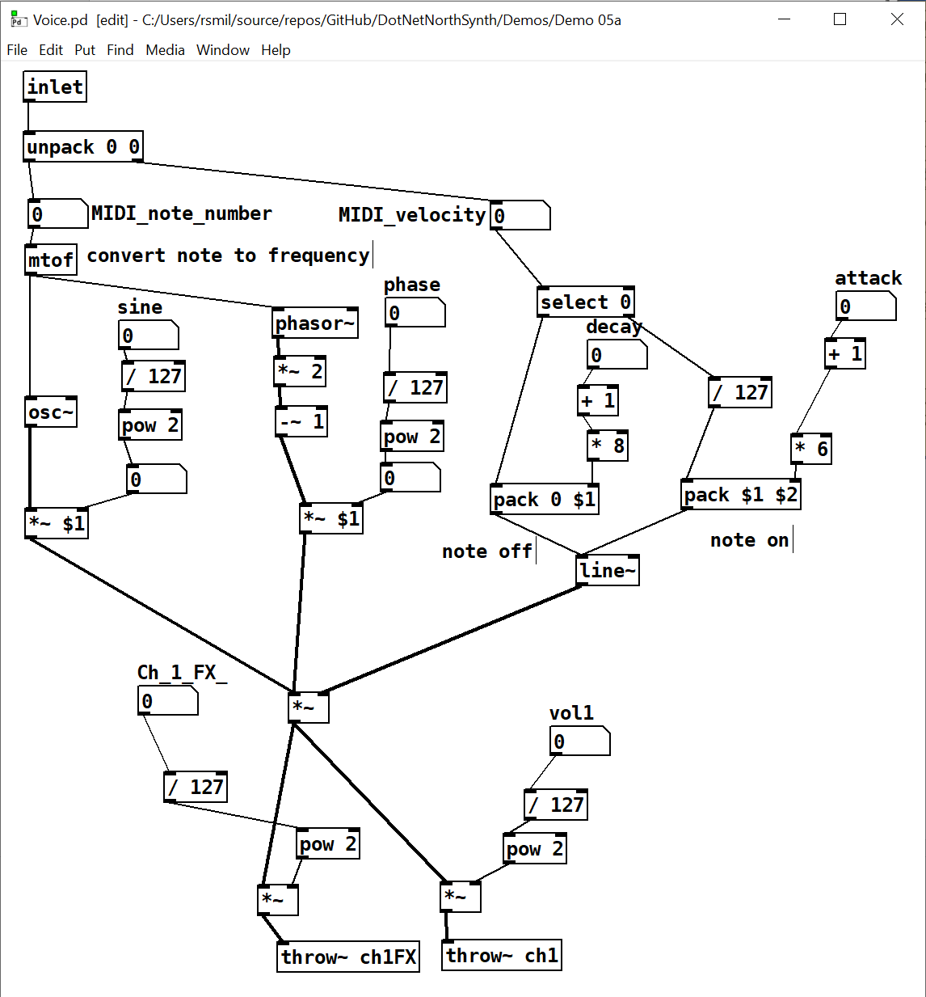
The voice patch
This is the patch that plays notes
It is based on the simple version we made earlier, but it has both sine and triangle wave sounds to make things more interesting
Let’s take a look at a few key features

Slide 44
Sound source
The sound source is the same as our original keyboard
We get a note and use it to make a signal
The inlet to the patch receives a packed element containing the MIDI note number and velocity
It also receives a sine volume level

Slide 45
Sound source
This sequence creates a triangle wave that makes the sound more interesting
Both sound signals are mixed on the input of the level control for the keyboard

Slide 46
Sound level
The voice uses a line to make the volume go up and down as it is played
This lets us change the attack and decay of the note when it is played
Attack lifts the volume to 1
Decay drops it down to 0
The length of the line determines how long the effect takes

Slide 47
Throwing signals
The throw~ object can throw an audio signal to a named destination
This is how our different sound generators can be combined to make the final output from the synth
Throw is a many to one
Lots of things can send to one receiver

Slide 48
Logarithmic changes
The level controls don’t move from 0 to 1 in a linear way
This is because our ears don’t work that way with volume
Instead we use the pow operator to square the signal and make it logarithmic

Slide 49
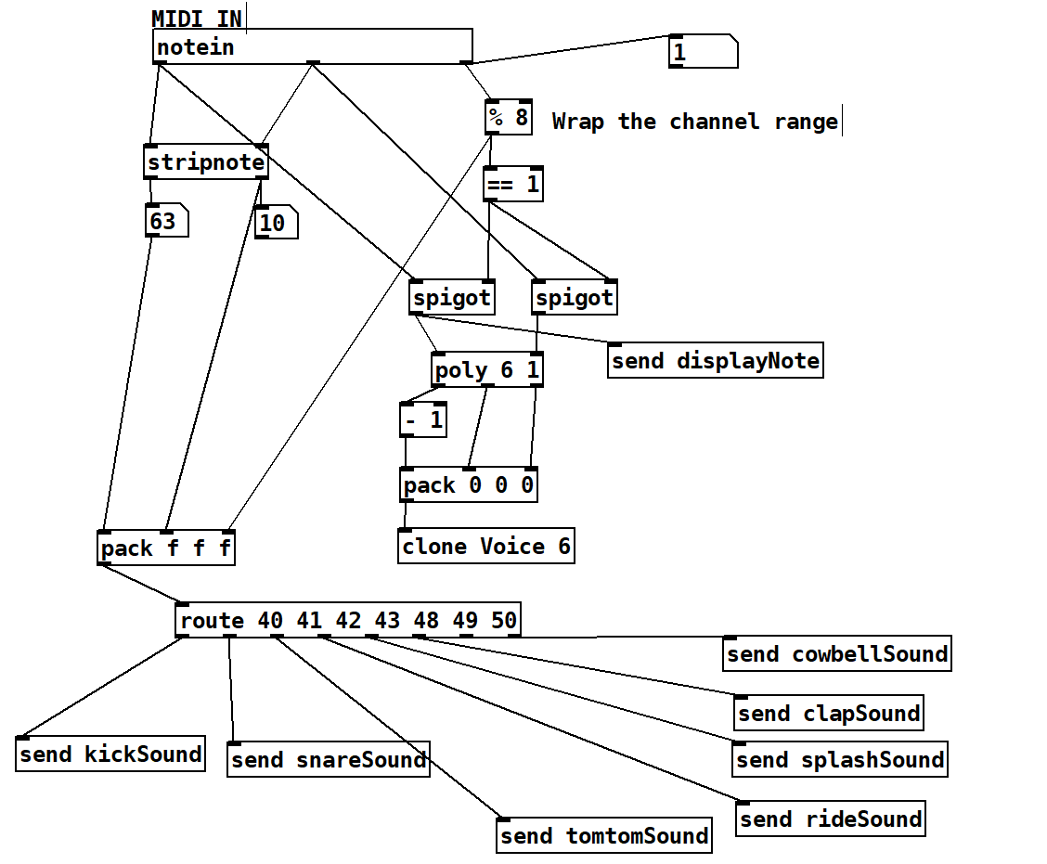
Multiple voices
This is the patch that sends notes to voices
It uses the clone object to make 6 copies of the Voice so we can play 6 notes at once

Slide 50
Notes and sounds
Channel 1 plays notes, other channels are used to play samples
The route object can route a message depending on a value
Value 40 means send the kicksound
Value 50 means cowbell

Slide 51
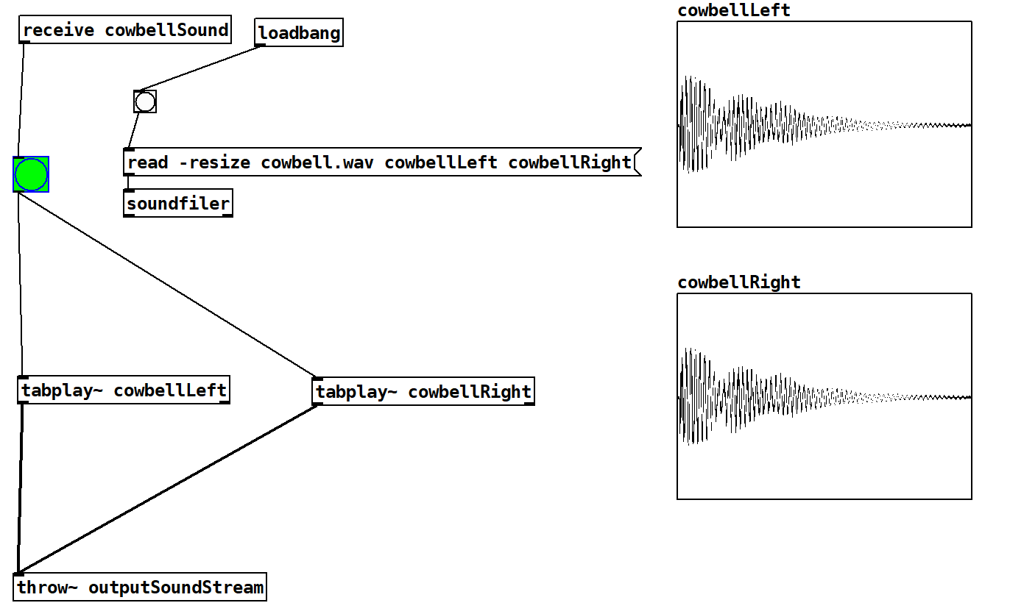
Playing samples
This patch loads and plays the cowbell sample
You can view the contents of arrays as graphs

Slide 52
Just the start…
There are lots of other things you can use Pure Data to do
There are objects that do reverberation, you can connect devices over a network and send them messages
You can make up sliders and use them to change values
Let’s have a quick play…

Slide 53
Demo 5: Chocolate Synthbox
Notes:
Open up the PCSynthboxMain patch in Demo 05 and show how great it sounds.
Twiddle the knobs to change the sounds. Explain that the first time they change is when the controls will line up.

Slide 54
PICO and MIDI

Slide 55
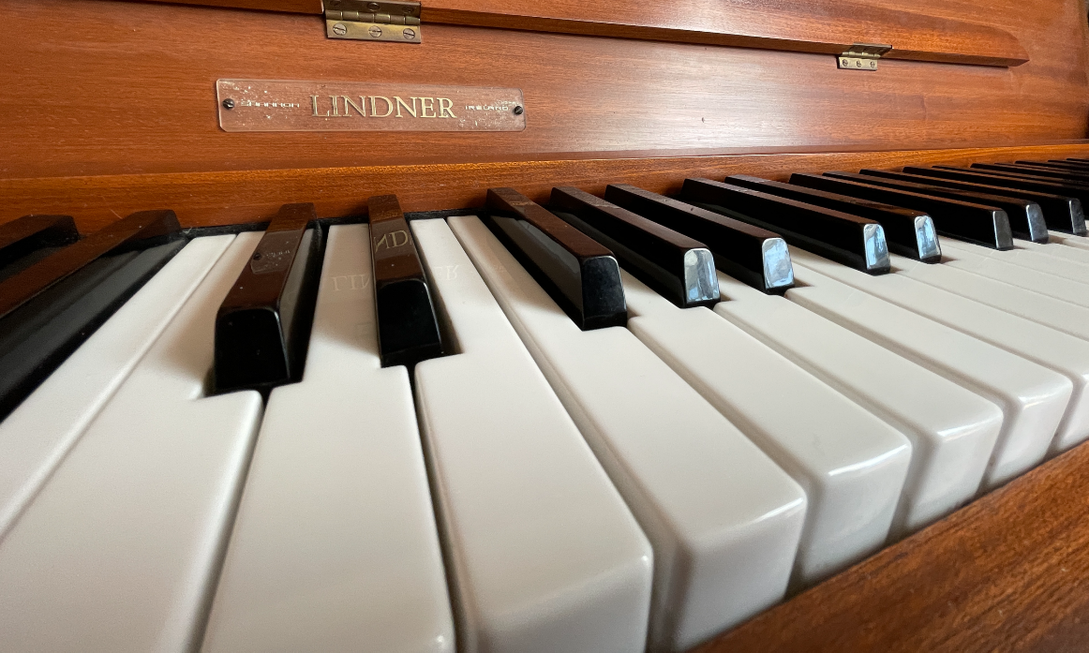
Music Hardware
Flashing lights and making beeping noises is all very well, but what about making music?
We can make an embedded device into a MIDI device
Lots of keyboards (and computers) understand MIDI (Musical Instrument Digital Interface)
We can make something that sends note messages to control the sound output of synthesizers and keyboards

Slide 56
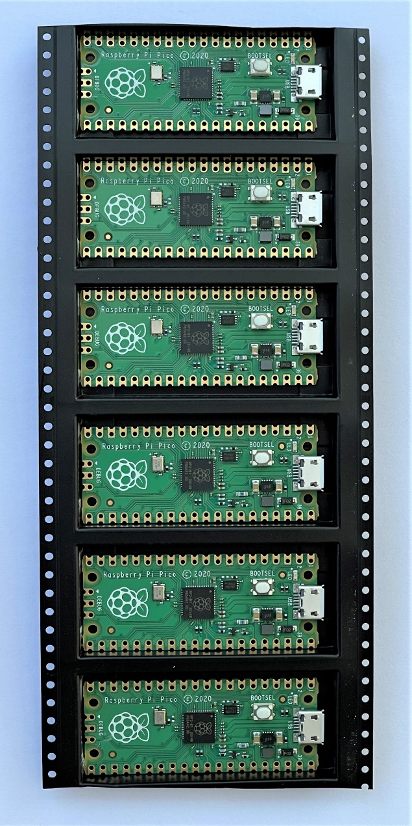
Raspberry Pi PICO
The Raspberry Pi PICO is a great device for embedded projects
Dual core processor, lots of EEPROM and ram
It run Circuit Python which has built-in support for MIDI messages
They are only a few pounds each and they have loads of hardware connections

Slide 57
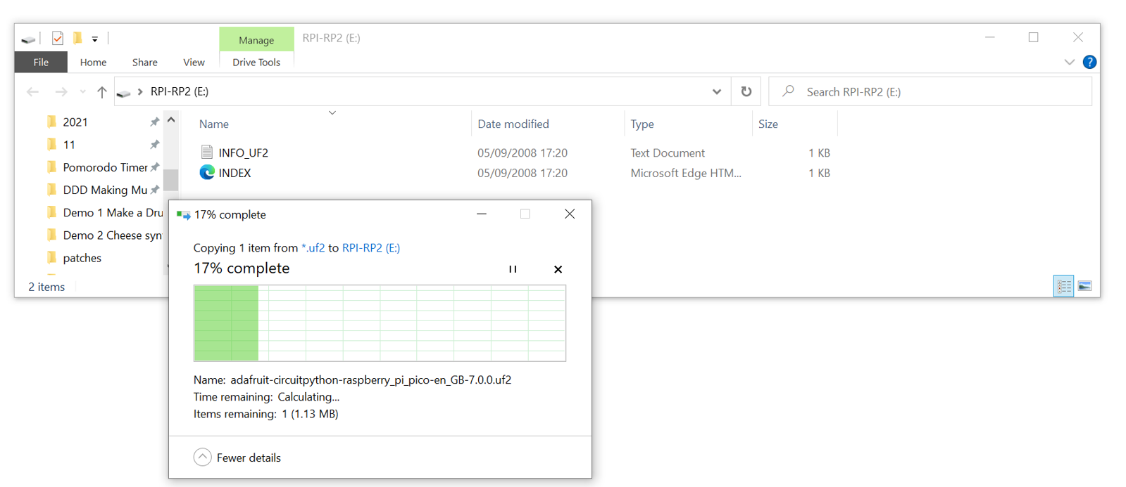
Installing Circuit Python
Circuit Python is a free download from circuitpython.org/board/raspberry_pi_pico/
Hold down BOOTSEL on your PICO when you plug it in and it will appear on your PC as a mass storage device
Drag the firmware image into that storage to install it
It then appears as another device running Circuit Python

Slide 58
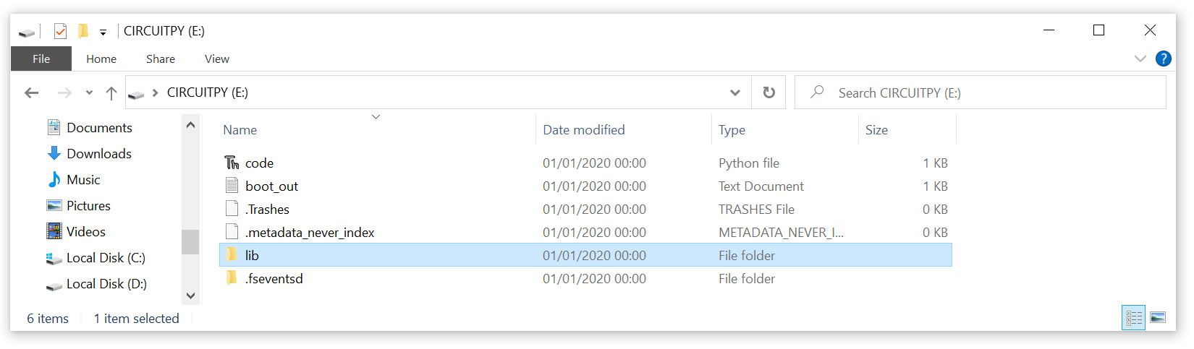
The Circuit Python storage device
code.py is the program that runs when the device starts
You can store data and other programs on the device too
The lib folder holds any libraries that your application needs
We need to add some to libraries to support MIDI output

Slide 59
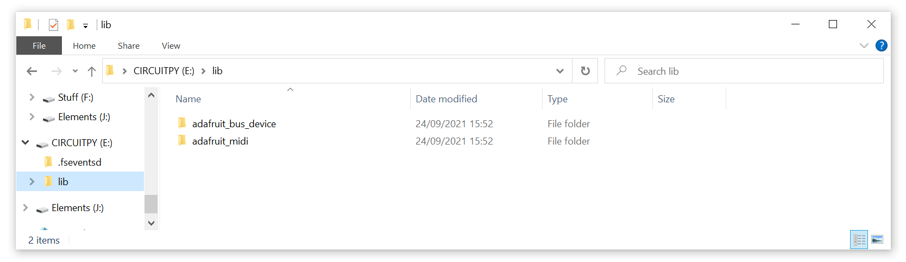
Installing libraries
To use MIDI with Circuit Python you need to install some extra libraries
You can find them here:
circuitpython.org/libraries
They are installed by dragging into the lib folder

Slide 60
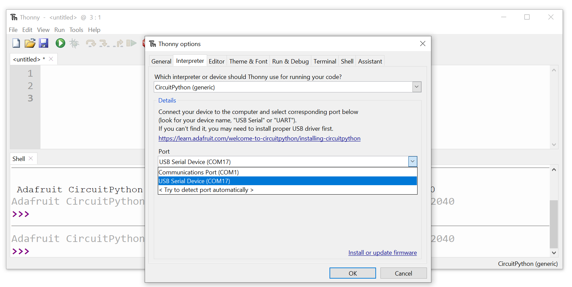
Thonny
I use an app called Thonny to edit and deploy the Python code
It is freely available for lots of platforms from thonny.org
You connect it to the embedded device

Slide 61
MIDI send
This Python code sends MIDI note messages
It imports the libraries, creates a MIDI object and then uses it to send 10 note values
Note that the program is sending messages to the MIDI port and the serial port over a single USB connection
import usb_midi
import adafruit_midi
from adafruit_midi.note_on import NoteOn
from adafruit_midi.note_off import NoteOff
import time
midi = adafruit_midi.MIDI(midi_out=usb_midi.ports[1],
out_channel=0)
for note_number in range(66,72):
print("Playing:",note_number)
midi.send(NoteOn(note_number, 80))
time.sleep(0.5)
midi.send(NoteOff(note_number,0))

Slide 62
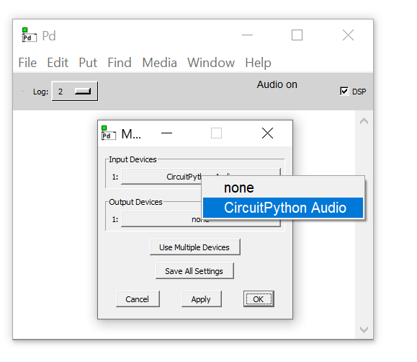
Pure Data Configuration
We have to configure Pure Data to receive the MIDI notes from the PICO
Go to File->Preferences->MIDI to open the MIDI settings dialog
The PICO turns up as “Circuit Python Audio”

Slide 63
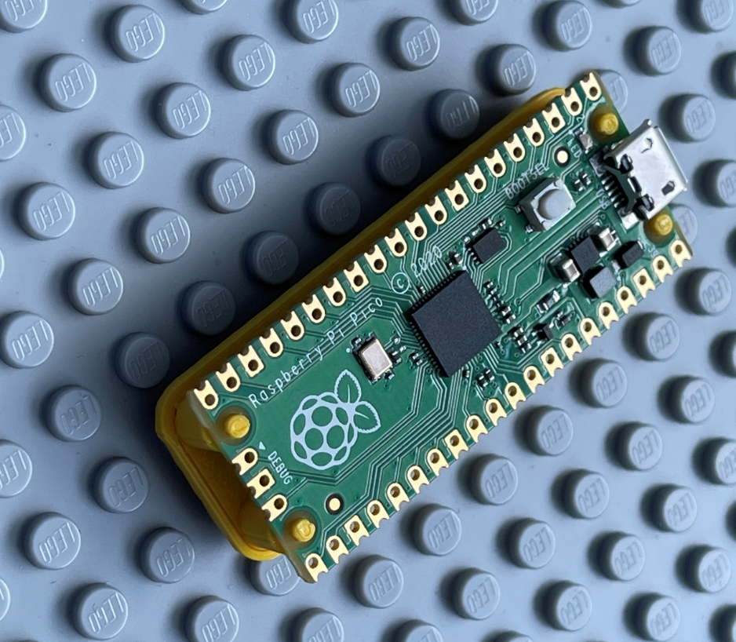
Demo: 6 MIDI from PICO
A Python program that plays notes
Notes:
Exit Pure Data
Unplug everything from the USB
Plug in the bare PICO
Explain that a Circuit Python device appears as a disk drive.
Show the contents of the disk drive, including the lib folder.
Explain that we can drop Python library files here which can be used by the application.
Start Thonny
Connect the PICO to Thonny.
Explain that the code program runs when the PICO powers up
Start Pure Data
Connect Pure Data to the MIDI device
Start the Demo 5 synth
Run the program in Thonny.

Slide 64
The PICO MIDI CheeseBox and Crackers Controller

Slide 65
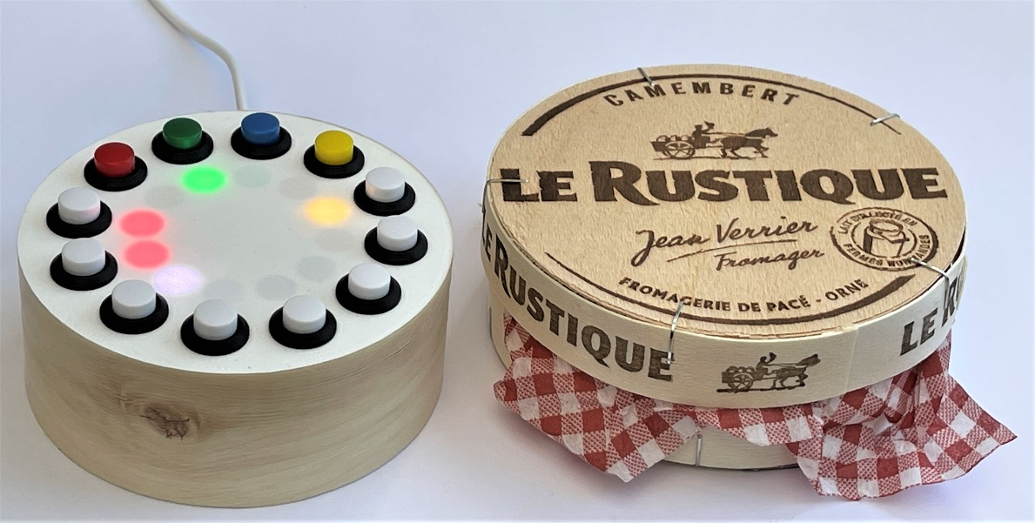
The PICO MIDI CheeseBox
This is a MIDI device that sends notes to any MIDI equipped device
It is controlled via buttons and lights
It is powered by a Raspberry Pi PICO and 500 lines of Circuit Python
It provides a four channel sequencer and keyboard

Slide 66
The PICO MIDI CheeseBox
You can buy MIDI keyboards and controllers
They send MIDI messages when you press keys and turn dials
I thought I’d make my own MIDI device using a PICO, a ring of LEDS and 12 pushbuttons
It is powered by a Raspberry Pi PICO and 500 lines of Circuit Python
It provides a four channel sequencer and keyboard
You can play it as a keyboard, or you can make it sequence notes

Slide 67
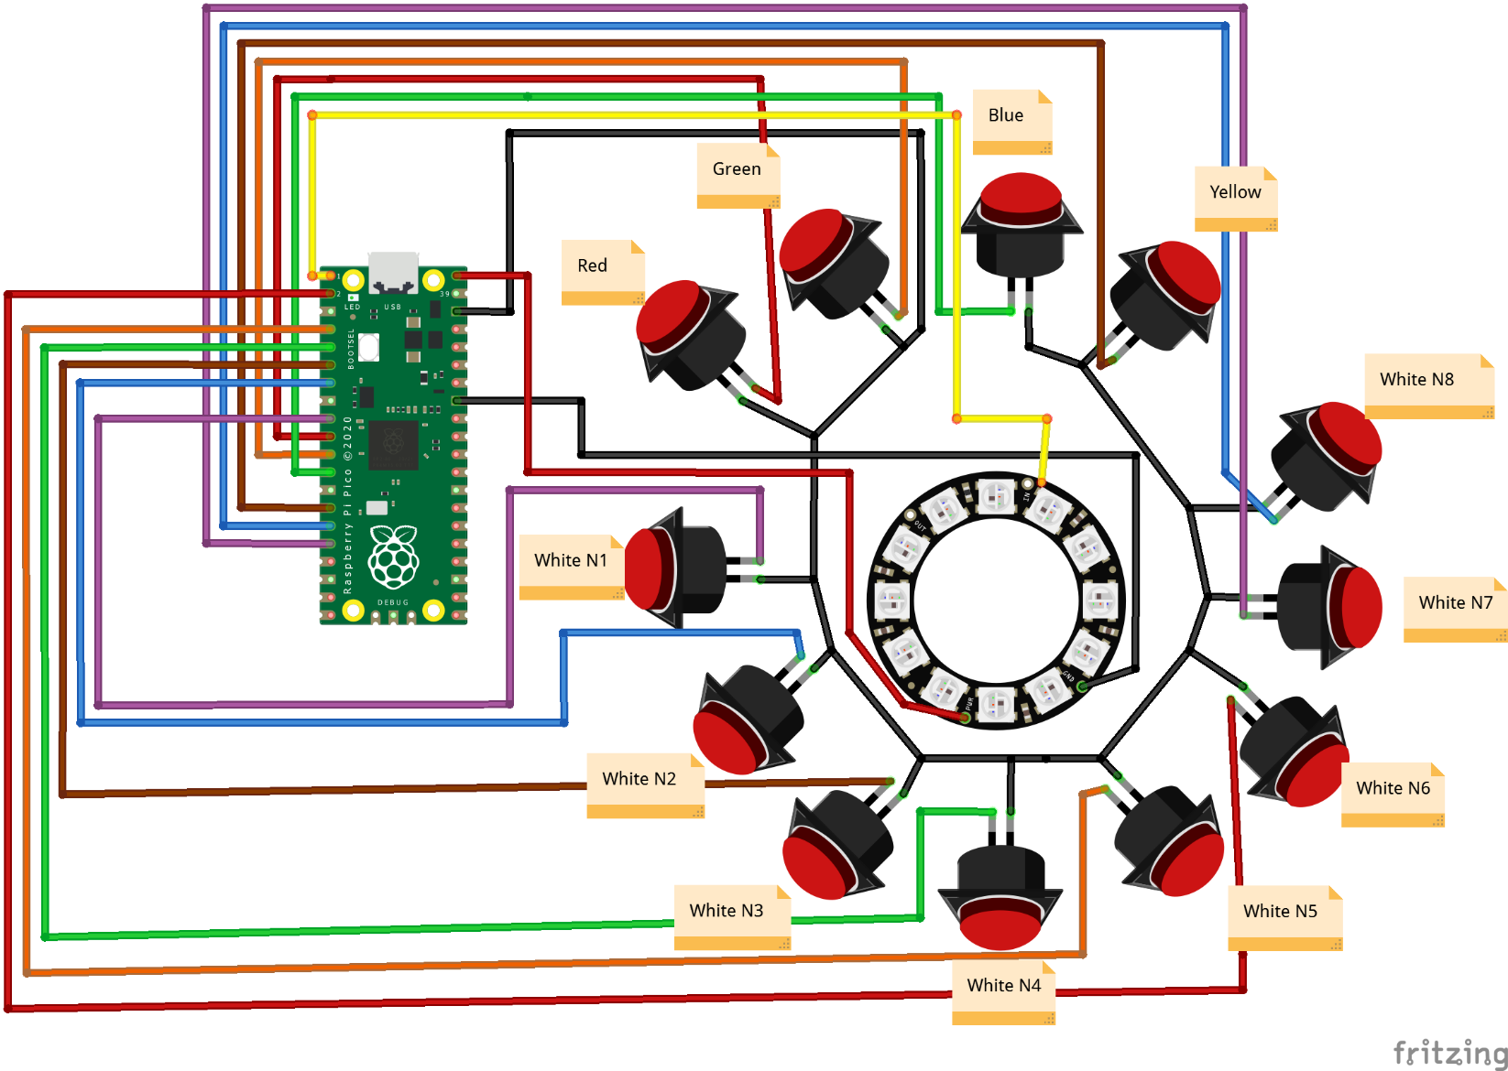
Circuit Diagram
I want to show you this because it took ages to draw…
There are 12 buttons and a 12 light pixel ring

Slide 68
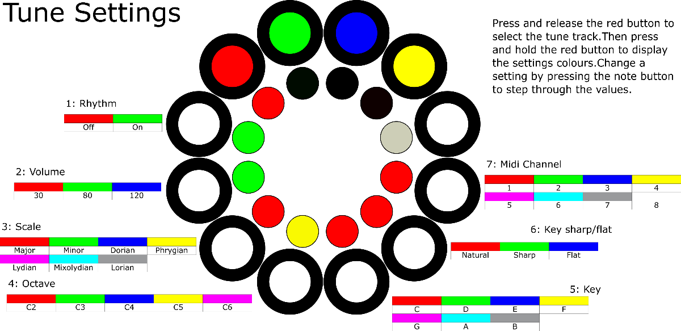
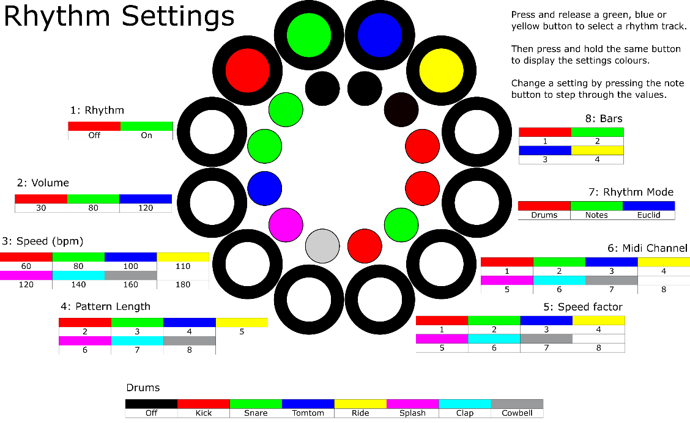
User Interface
These also took a while to draw
The show how to control the device
The coloured buttons represent recording tracks
The white buttons represent notes or steps in a sequence
The lengths of the sequences can be changed to make Euclidean rhythms

Slide 69
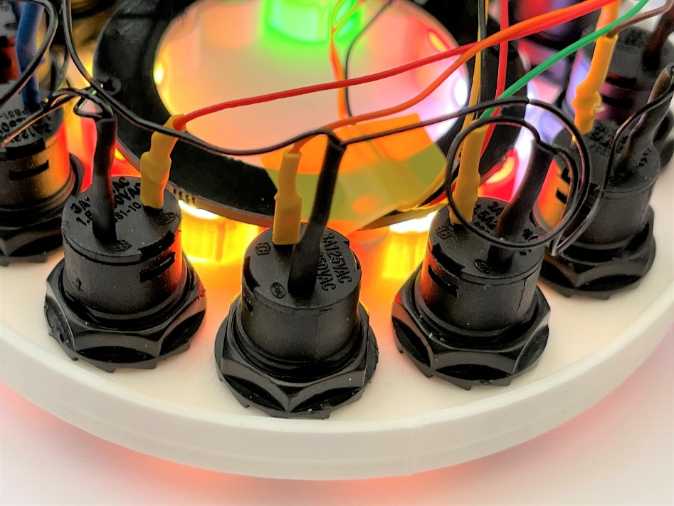
Funky sounds
Each of the three rhythm tracks can contain up to 32 steps
Each step can play a drum or a note
If we change the length of each step we can get some note patterns that precess over a long time
This can make some interesting beats
We can also create notes by summing the values on tracks to create interesting progressions

Slide 70
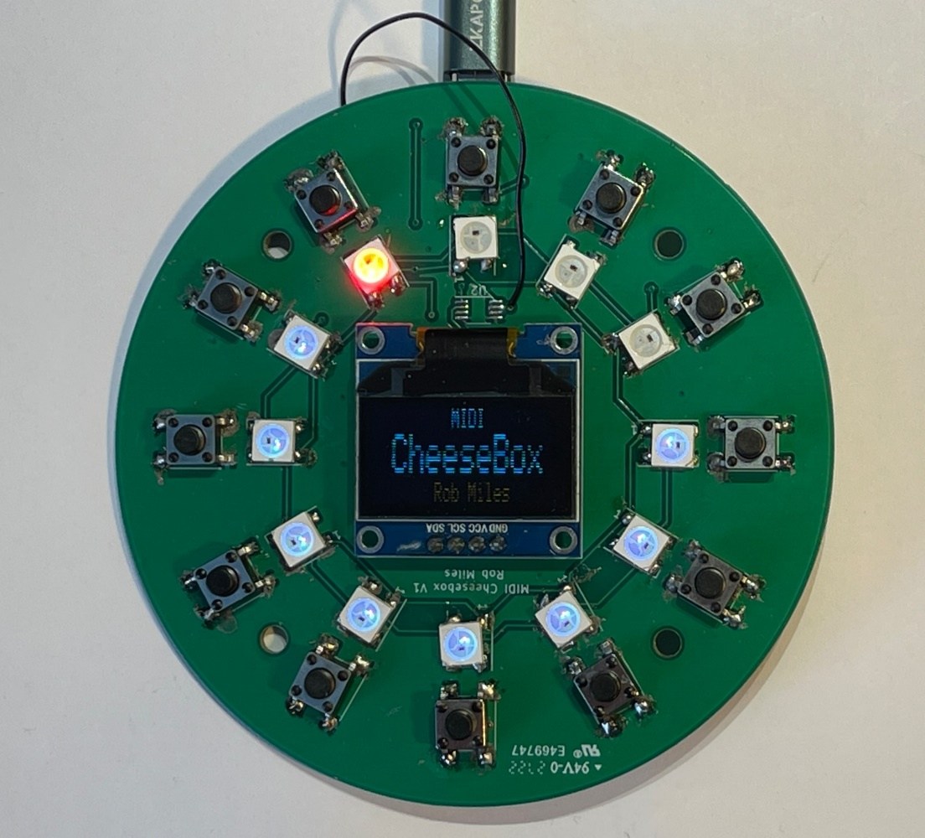
CheeseBox PCB
I’ve now got a PCB for the CheeseBox
I didn’t design it
The plan is to have a go at making a proper product
The PCB also includes provision for an OLED display

Slide 71

Demo 7: PICO Cheesebox
Making some interesting beats
Notes:
Exit Pure Data
Plug in the CheeseBox and the Crackers Controller
Start Pure Data
Set up the MIDI for multiple inputs and connect the two devices.
Load the synth in Demo 7
Play some tunes on the syth.
Press green and add some beats.
Press blue and add more beats
Press yellow and add even more beats
Now talk about a bit of random music.
Go back to green.
Set the sound mode to Notes: [7: Green]
Set the MIDI channel to 1; [6: Red] Beats will now be played as notes
Now go to Blue
Set the sound mode to Notes: [7: Green]
Set the MIDI channel to 1; [6: Red] Beats will now be played as notes
Should hear a repeating harmony
Now change blue to a pattern length:
Set pattern length to 6: [4: Magenta]
Repeats should start to precess. Now Change to sum mode
Go to Blue:
Set Sound mode to sum: [7:Blue]
Go to Yellow:
Set Sound mode to sum: [7:Blue]
Should now have a repeating precessing sound thing. Play around with the reverb and the notes

Slide 72

The Crackers controller
The CheeseBox lets you create notes and rhythms but it doesn’t control the type of the sound
The Crackers controller generates MIDI control messages that can be used to change the behaviour of a Pure Data synthesizer

Slide 73

A long, thin circuit this time..
Each of the rotary controls also has a push button

Slide 74

Crackers controller
The Crackers Controller has four rotary controls
These send out MIDI “control change” messages that are used to control settings in the synthesizer
We can change the level of sine and sawtooth elements of the sound, along with the attack and decay of the note

Slide 75

Synth Control
Messages sent from the controller patch are picked up by the voice patches and used to configure the sound output
We can watch the values change in the patch as they are received from the controller

Slide 76

Demo 4: Crackers controller
Change the sound
Notes:
Leave the demo running and move over to the slider display. Explain how the four pages work.

Slide 77

Chocolate Synthbox
You can run Pure Data on lots of PCs
But I wanted a free standing device with reasonable speakers
So I made the Chocolate Synthbox
Powered by a Raspberry Pi 4 and a PICO
The PICO looks after the controls and the screen
Us a sound-hat which provides good quality output
Which can get quite loud..

Slide 78

Yay! Another circuit
The PICO and the PI are linked by a serial connection
The Pure Data program sends commands for the display and receives inputs from the two rotary controllers
This is used for a bit of graphical fun

Slide 79

Coloured Lights
Coloured lights were not originally part of the plan
But once I had the panel…..
The lights are trigged by notes on the 3 rhythm tracks
They are hard-wired at the moment but will be configurable later

Slide 80
Demo
Time for a bit of fun with the hardware
Notes:
Unplug the controllers, connect them into the Chocolate Synth and say a prayer to the demo gods.

Slide 81
Summary
You should buy my books and reads my articles
Pure Data is a graphical environment that you can use to create unique sounds – and learn a new way to create programs
The Raspberry Pi PICO is a great way to create embedded applications – and you can use Python to do it
The MIDI standard allows you to connect devices and pass note and control messages
Demos and slides: https://github.com/CrazyRobMiles/DotNetNorthSynth
www.robmiles.com

